Slide 1

PHOTONICS
PHT100 Engineering Physics A
Module V: Part 2

Slide 2

What is Photonics & Why Photonics is important
Photonics is the science of light. It is the technology of generating, controlling, and detecting light waves and photons, which are particles of light.
The characteristics of the waves and photons can be used to explore the universe, cure diseases, and even to solve crimes. The colors of the rainbow are only a small part of the entire light wave range, called the electromagnetic spectrum. Photonics explores a wider variety of wavelengths, from gamma rays to radio, including X-rays, UV and infrared light.
Why Photonics is important
Photonics is everywhere; in consumer electronics (lighting, displays, barcode scanners, DVD players, remote control), telecommunications (internet, phones , Wi-Fi, Li-fi, NFC, CCTV, FTTH), health (laser surgery, blood analyzers, fitness bands, endoscopes), manufacturing industry (laser cutting and machining), defense and security (infrared camera, remote sensing), entertainment (holography, laser shows, projectors, camera), etc
The display (computer monitor/Projector/laptop/tab/mobile phone) where you are viewing this presentation is a product that comes under photonics

Slide 3
Contents
1. Light Emitting Diode
2. Photodetector
4. Junction Photodiode
6. Solar Cell
7. Optical Fiber
8. Numerical Aperture (NA)
9. Advantages of Optical Fibers
10. FO Communication System
11. Intensity Modulated Sensor
12. Phase Modulated Sensor
5. PIN Photodiode
3. Photodiode

Slide 4

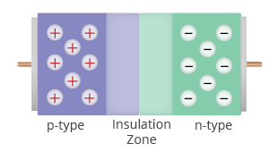
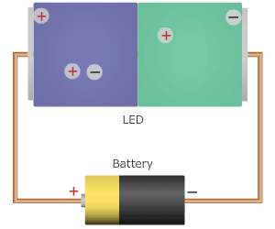
Light Emitting Diode (LED)
LED simple electronic device that is formed by simply attaching an n-type and a p-type semiconductor to each other, as shown in figure1. On attaching the two semiconductors, a weak barrier (depletion region) forms a between them. This barrier prevents the negatively charged electrons in the n-type material from combining with the positively charged holes in the p-type material. As seen in Figure 1, the diode has positive and negative charges bunched up on the two sides of the barrier. In this state, the diode is said to be turned off.
Figure 1: A diode
The potential barrier can be overcome by applying a high enough voltage between the two ends of the diode. That is, the diode can be turned on by connecting the p-type and n-type semiconductors to the positive and negative ends, respectively, of a power source such as a battery, as shown in Figure 2. This allows the charges to pass freely through the depletion layer. When pairs of electrons and holes collide and recombine with each other, they release energy as flashes of light. Hence the name light emitting diode. When an LED is turned on, millions of electron-hole pairs recombine simultaneously, making the LED appear as if it is glowing like a bulb. When the power source is disconnected, the depletion layer is formed again, the electrons and holes stop recombining, and no light is emitted.
Figure 2: A light emitting diode in action

Slide 5
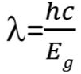
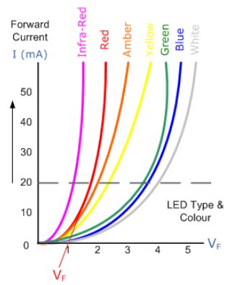
Light Emitting Diode (LED)
Wavelength of light emitted by an LED is given bey the relation
where Eg is the band energy gap
V-I Characteristics of LED
The colour of light emitted depends on band gap energy E_{g}. Intensity of light emitted increases with increase of forward current. Generally LED are monochromatic. White light is produced from LEDs by
RGB (Red Green Blue) Mixing: Mixing of light from different LEDs
Phosphor conversion: A phosphor is used to absorb light in blue or ultraviolet region and to emit white light

Slide 6
Advantages & Disadvantages of LED
Advantages
Long life, if used in a suitable environment. Saving future maintenance & cost.
Very high efficiency & lower power consumption compared to incandescent lights (up to 80% cheaper to run).
Light weight and miniature size.
Lower heat output, conventional incandescent lights waste about 90% of their power on heat output.
Typically lower infra-red and ultraviolet output.
Typically faster switching time and less likely to be damaged by on off cycles
They are usually more rugged. There is normally no glass to break and no filament to damage via vibration.
They are more environmentally friendly. They last longer, don't result in the emissions of as much CO2 and normally don't contain any toxic materials, like the mercury vapor in CFL.
Disadvantages
High initial price.
May fail prematurely in high temperature conditions.
Small increase in voltage can cause permanent damage to LED
Light output and colour quality can degrade over the life of the bulb (but other lights also have this problem)

Slide 7
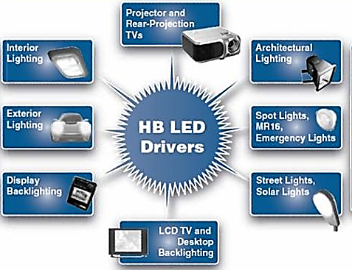
Applications of LED
With millions of existing products on the market, and more on the way each day, LEDs are used in almost everyone. From indication lights, computer components, watches, medical devices, the list goes on and on. A few are listed here
Illumination With LEDs
Architectural Lighting, Signage (Channel Letters), Machine Vision, Retail Displays, Emergency Lighting (Exit Signs), Neon and bulb Replacement, Flashlights, Accent Lighting - Pathways, Marker Lights
Signal Application With LEDs
Traffic, Rail, Aviation, Tower Lights, Runway Lights, Emergency/Police Vehicle Lighting
Automotive Applications With LEDs
Instrument Panels & Switches, Courtesy Lighting, CHMSL, Rear Stop/Turn/Tai, Retrofits, New Turn/Tail/Marker Lights
Consumer Electronics & General Indication
Household appliances, VCR/ DVD/ Stereo/Audio/Video devices, Toys/Games Instrumentation, Security Equipment, Switches
Mobile Applications With LEDs
Mobile Phone, PDA's, Digital Cameras, Lap Tops, General Backlighting
Photo Sensor Applications With LEDs
Medical Instrumentation, Bar Code Readers, Color & Money Sensors, Encoders, Optical Switches, Fiber Optic Communication
Applications of LED

Slide 8
Photodetector
Photodetector is a semiconductor device that converts light into current. The current is generated when photons are absorbed in the detector.
Properties of
Sensitive only in spectral region (range of optical wavelengths)
Support only a range of optical input power.
Support only a range of frequencies.
Dark current; the small amount of current that is produced when no light is present.
Photovoltaic Effect: is the phenomenon of production of an emf across junction of two dissimilar materials by incidence of light.
First demonstrated by Edmond Becquerel in 1839

Slide 9
Photodiode
A photodiode is one type of light detector, used to convert the light into current or voltage. These diodes have a slow response time when the surface area of the photodiode increases. Photodiodes are similar to regular semiconductor diodes, but that they may be either visible to let light reach the interior part of the device.
Basic photodiode theory of operation
Light energy can be considered in terms of photons or packets of light. When a photon of sufficient energy enters the depletion region of a semiconductor diode, it may strike an atom with sufficient energy to release the electron from the atomic structure. This creates a free electron and a hole (i.e. an atom with a space for an electron).
The electrons and holes may remain free, or other electrons may combine with holes to form complete atoms again in the crystal lattice. However it is possible that the electrons and holes may remain free and be pulled away from the depletion region by an external field. In this way the current through the diode will change and a photocurrent is produced.
Types of Photodiode
Although there are numerous types of photodiode available in the market and they all works on the same basic principles, though some are improved by other effects. The working of different types of photodiodes work in a slightly different way, but the basic operation of these diodes remains the same. We will study about two types of the photodiodes only; Junction photodiode & PIN Photodiode.

Slide 10
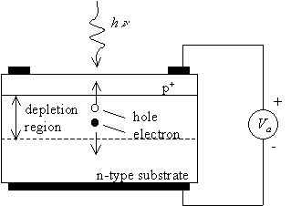
Junction Photodiode
Made of a pn junction, with a thin p-layer on thicker n-type material layer
Light enters the junction through p-layer.
When a photon is incident on either n or p type , it gets absorbed and an electron is released from valance band and it goes to conduction band. This creates a hole in valance band.
When light is incident on photodiode , it results in a large number of electron-hole pairs, called photo-carriers which results in current (photocurrent)

Slide 11
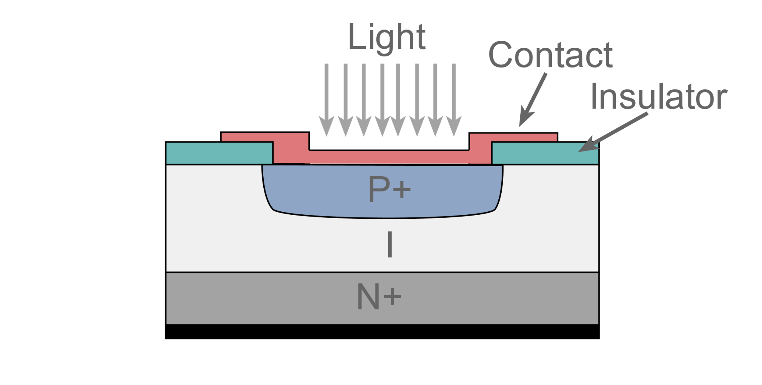
PIN Photodiode
A wide intrinsic semiconductor is introduced between heavily doped p type and n-type regions
Intrinsic layer absorbs more photons from incident light and create more electron-hole pairs
Presence of intrinsic layer improves sensitivity, efficiency and speed of the detector in comparison with pn-junction photodiode

Slide 12

Applications of Photodiode
Used in consumer electronics devices like smoke detectors, compact disc players, and televisions and remote controls.
Photodiodes are frequently used for exact measurement of the intensity of light in science & industry. Generally, they have an enhanced, more linear response.
Photodiodes are also widely used in numerous medical applications like instruments to analyze samples, detectors for computed tomography and also used in blood monitors.
Used for lighting regulation and in optical communications.

Slide 13
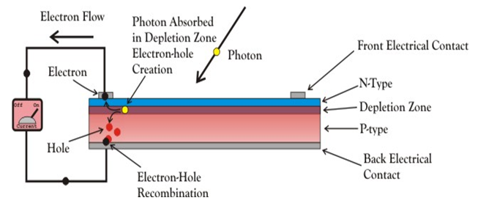
Solar Cell
A solar cell (also known as a photovoltaic cell or PV cell) is defined as an electrical device that converts light energy into electrical energy through the photovoltaic effect. A solar cell is basically a p-n junction diode. Solar cells have its electrical characteristics (current, voltage, or resistance) that vary when exposed to light.
In a solar panel an array of solar cells connected in series( to increase output voltage ) and parallel ( to increase output current).
A solar cell is basically a junction diode, although its construction it is little bit different from conventional p-n junction diodes. It have a very thin layer of p-type semiconductor on a relatively thicker n-type semiconductor. Small electrodes are fixed on the top of the p-type semiconductor layer so that it do not obstruct light to reach the thin p-type layer. Just below the p-type layer there is the p-n junction. An electrode is also fixed at the bottom of the n-type layer.

Slide 14
Working Principle of Solar Cell
When light reaches the p-n junction, the light photons can easily enter in the junction, through very thin p-type layer. The light energy, in the form of photons, supplies sufficient energy to the junction to create a number of electron-hole pairs. The incident light breaks the thermal equilibrium condition of the junction. The free electrons in the depletion region can quickly come to the n-type side of the junction. Similarly, the holes in the depletion can quickly come to the p-type side of the junction. Once, the newly created free electrons come to the n-type side, cannot further cross the junction because of barrier potential of the junction.
Similarly, the newly created holes once come to the p-type side cannot further cross the junction because of same barrier potential of the junction. As the concentration of electrons becomes higher in one side, i.e. n-type side of the junction and concentration of holes becomes more in another side, i.e. the p-type side of the junction, the p-n junction will behave like a small battery cell. A voltage is set up which is known as photo voltage. If we connect a small load across the junction, there will be a tiny current flowing through it.

Slide 15
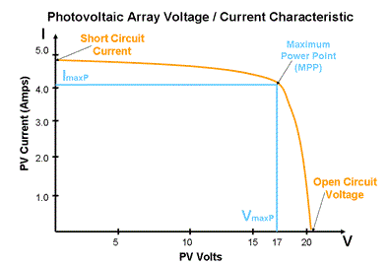
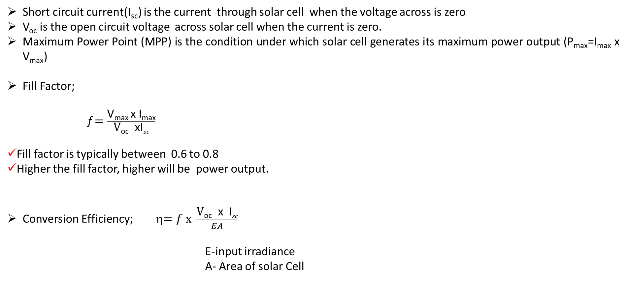
Solar Cell
Short circuit current(I_{sc}) is the current through solar cell when the voltage across is zero
V_{oc} is the open circuit voltage across solar cell when the current is zero.
Maximum Power Point (MPP) is the condition under which solar cell generates its maximum power output (P_{max}=I_{max} x V_{max})
Fill Factor;
f $=\frac{\text{V}\text{max} \text{x} \text{I}\text{max}}{\text{V}\text{oc} \text{xI}sc}$
Fill factor is typically between 0.6 to 0.8
Higher the fill factor, higher will be power output.
Conversion Efficiency; η$=f x \frac{\text{V}\text{oc} \text{x} \text{I}sc}{EA}$
E-input irradiance
A- Area of solar Cell

Slide 16
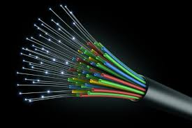
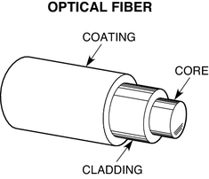
Optical Fiber
Optical fibers are circular dielectric wave-guides that can transport optical energy and information.
They have a central core surrounded by a concentric cladding with slightly lower (by ≈ 1%) refractive index.
Optical fibers are made of glass and plastic. Plastic fibers are more flexible. But due to higher attenuation/power loss, plastic fibers are not used for long haul transmission

Slide 17
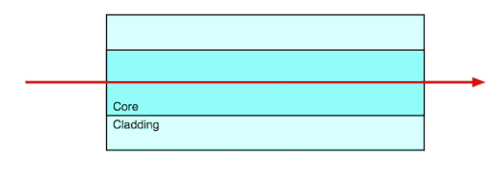
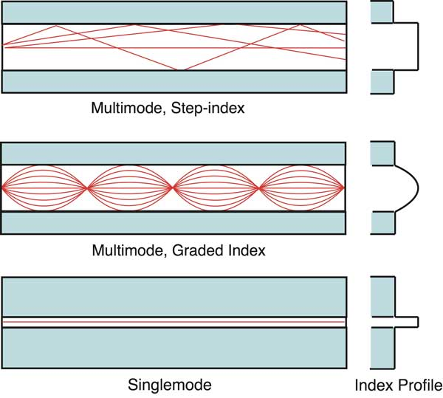
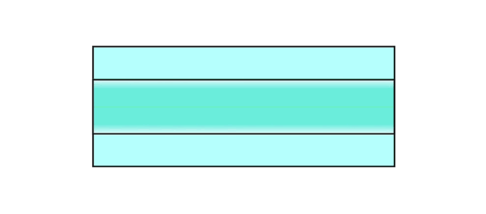
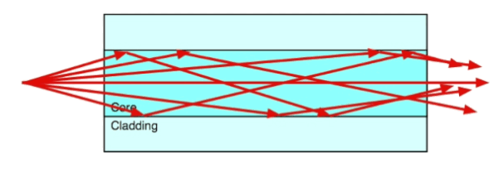
Types of Optical Fiber
Core refractive index is constant .
Refractive index reduces abruptly at core-cladding boundary
Refractive index of core gradually reduces as the distance increases from the centre
Core refractive index is constant .
Refractive index reduces abruptly at core-cladding boundary
In single mode fiber core diameter is so small that it allows only one mode of propagation of light

Slide 18
Advantages of Optical Fiber
Low transmission loss. Typical attenuation of a Single mode fiber is 0.15dB/km. This reduces the requirement for repeaters /amplifiers.
Made of silica glass and have a diameter of 100 to 250μm only. This results in low volume and weight making it easy to handle.
Immune to electromagnetic interference hence eliminate cross talk.
Cost effective: Made of silica glass, which is abundant in nature.
Non-flammable: Because no electricity is passed through optical fibers, there is no fire hazard.
Can be used in hazardous environments including high voltage environments.
High Bandwidth Over Long Distances. Presently available networks support upto 100GbPs.
Bell Labs demonstrated internet speeds of over 100 petabit×kilometer per second using fiber-optic communication (1petabit=125000gigabytes)

Slide 19
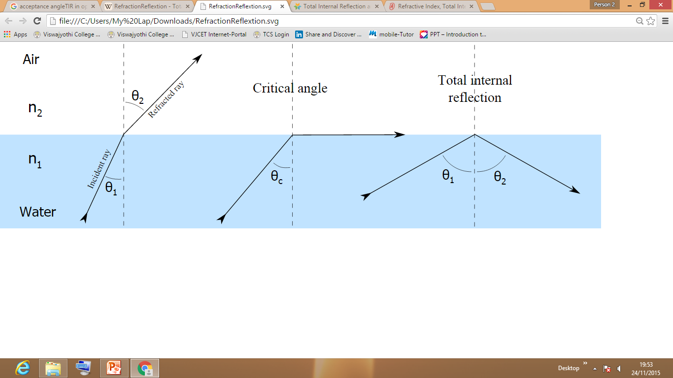
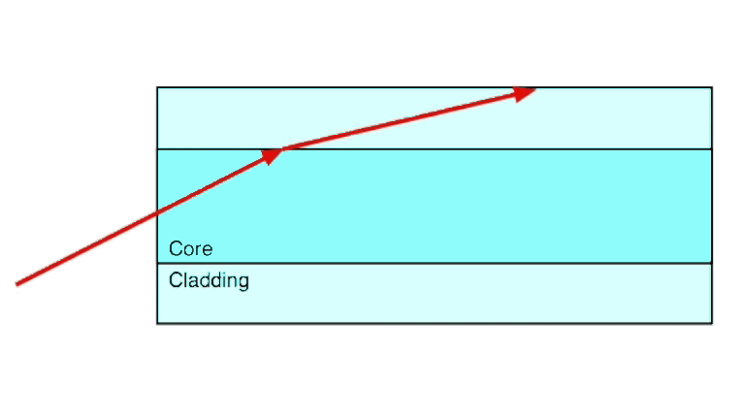
Working Principle of Optic fiber
Rarer Medium
Denser Medium
If the angle of incidence in the denser medium is greater than the critical angle, the incident ray is reflected back to the same medium totally. This phenomenon is called total internal reflection and this is the basic working principle of optic fiber.
Conditions for TIR
i. Light must travel from optically denser to optically rarer medium
ii. The angle of incidence in the denser medium must be greater than the critical angle

Slide 20
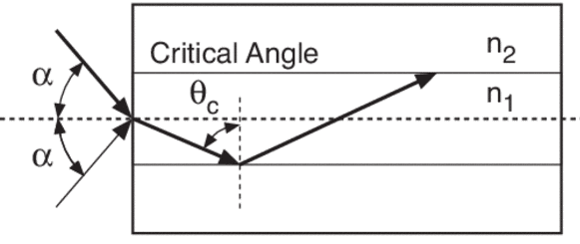
Numerical Aperture (NA)
Numerical Aperture (NA) of a fiber is a measure of light gathering capacity of fiber. NA is sine of maximum angle over which light is accepted in the fiber.
NA = Sin α_{m} where α_{m} is the acceptance angle
Numerical Aperture is the most important parameter that defines the characteristics of a fiber
The acceptance angle of an optical fiber is the maximum angle of a ray (against the fiber axis) hitting the fiber core which allows the incident light to be guided by the core.

Slide 21
Fiber Optic Communication System- Block diagram
Input Data: Generally it is from any device converts a non-electrical message into an electrical signal. Ex: microphones for converting sound waves into currents and video (TV) cameras for converting images into current. For data transfer between computers, the message is already in electrical form.
Encoder: It converts the electrical message into proper encrypted format. Encoded data is transmitted as a modulation over the light produced by the optical transmitter.
Optical Transmitter: A laser diode (LD) or a light emitting diode (LED) is used. They provide stable, single frequency waves with sufficient power for long distance propagation.
Optical Amplifier: It is used to amplify the signal. It is generally required in communications over 100km distance only.
Optical Receiver: A photodetector that convert the optical signal into electrical signal.
Decoder: It removes the encryption and separates the data from the carrier signal.
Output Data: Given to devices that converts electrical signal into desired format. Ex: Loud speaker, TV ,computer
Input Data
Encoder
Optical Transmitter
Optical Amplifier
Optical Receiver
Decoder
Output Data

Slide 22
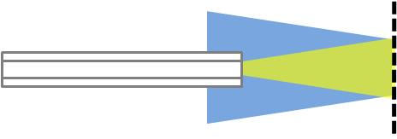
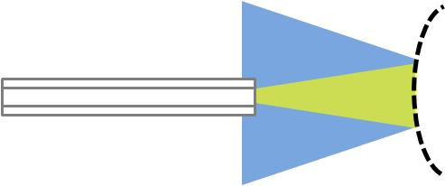
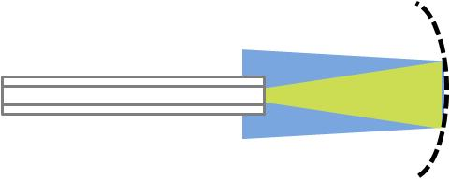
Intensity Modulated Sensor
Intensity Modulated sensors measure change in intensity, thereby measuring the parameter that cause the change.
LED
Reflecting Diaphragm
2x1
Photodetector
Diaphragm will change shape and oscillate based on the pressure change. This will result in variation in the intensity of reflected light.
Equilibrium high pressure Low pressure

Slide 23
Phase Modulated Sensor
Phase Modulated sensors measure change in phase of the light, thereby measuring the cause of the change
Measureand ( quantity or property that is measured)
Sensing Arm
Laser
output
1x2 Coupler
2x2 Coupler
At the output side the variation in phase is measured in relation to the reference light.
Reference Arm
Input light is split into two parts:
One part travels through reference arm and reaches output side unaltered.
Second part of light passes through sensing arm and will get affected by the measureand (ex; temperature, vibration)

Slide 24
Reference
https://www.wikipedia.org/
https://www.ledlightforyou.com/applications/index.jsp
https://www.electronics-notes.com
https://www.rp-photonics.com/encyclopedia.html
https://www.researchgate.net/figure/LED-packaging-technology-evolution-by-years_fig1_228598778
http://www.yourelectrichome.com/2018/02/block-diagram-of-optical-fiber.html
https://www.thefoa.org/tech/ref/basic/fiber.html

